Slide 1
Introduction to SVM
Kohki Mametani
>>> from sklearn import svm
>>> X = [[0, 0], [1, 1]]
>>> y = [0, 1]
>>> clf = svm.SVC(gamma='scale')
>>> clf.fit(X, y)
SVC(C=1.0, cache_size=200, class_weight=None,
coef0=0.0, decision_function_shape='ovr',
degree=3, gamma='scale',
kernel='rbf', max_iter=-1,
probability=False, random_state=None,
shrinking=True, tol=0.001, verbose=False)

Slide 2
Introduction to SVM
Kohki Mametani
>>> from sklearn import svm
>>> X = [[0, 0], [1, 1]]
>>> y = [0, 1]
>>> clf = svm.SVC(gamma='scale')
>>> clf.fit(X, y)
SVC(C=1.0, cache_size=200, class_weight=None,
coef0=0.0, decision_function_shape='ovr',
degree=3, gamma='scale',
kernel='rbf', max_iter=-1,
probability=False, random_state=None,
shrinking=True, tol=0.001, verbose=False)

Slide 3
Index
Hard-margin SVM
Two-class linear classification
Calculation of margin
Lagrange Multiplier
KKT condition
Soft-margin SVM
Slack variable
Penalty strength control by C
Non-linear SVM
Kernel function
Kernel trick
Not covered
Training algorithm of SVM
Multiclass classification
SVM for regression

Slide 4
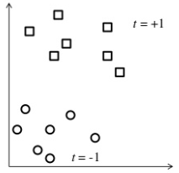
Two-class linear classification
Introduce SVM using a simple classification task, assuming linearly separable data

Slide 5
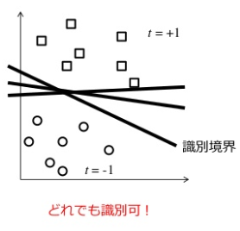
Two-class linear classification
Introduce SVM using a simple classification task, assuming linearly separable data
Multiple ways to draw decision boundary

Slide 6
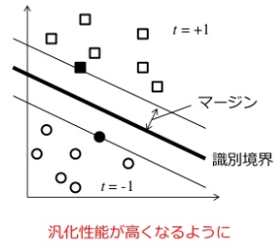
Two-class linear classification
Introduce SVM using a simple classification task, assuming linearly separable data
Multiple ways to draw decision boundary
→Pick the decision boundary which maximize the margin
→We need to know how to compute the distance to margin from data!

Slide 7
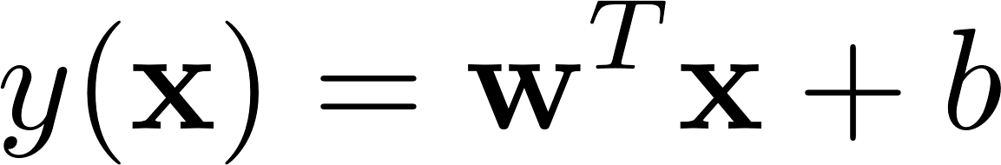
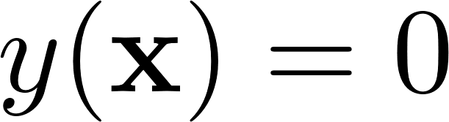
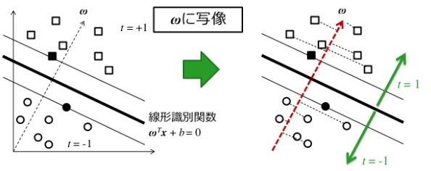
Two-class linear classification
Linear classifier
Decision boundary
: weight
: input (d-dim)
: bias

Slide 8
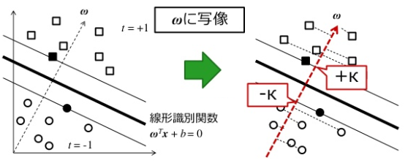

Two-class linear classification
Suppose the margin appears at distance $±κ$ from the decision boundary

Slide 9
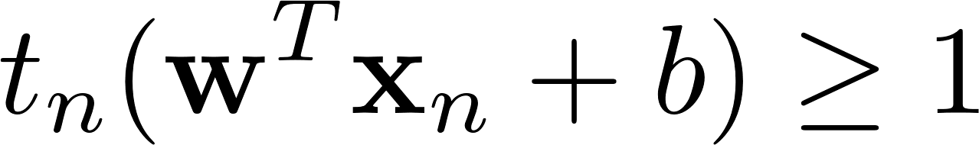
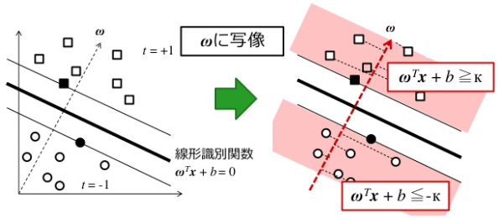
Two-class linear classification

Slide 10
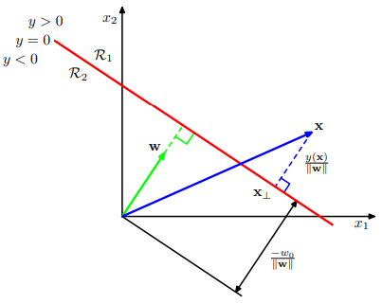
Calculation of margin

Slide 11
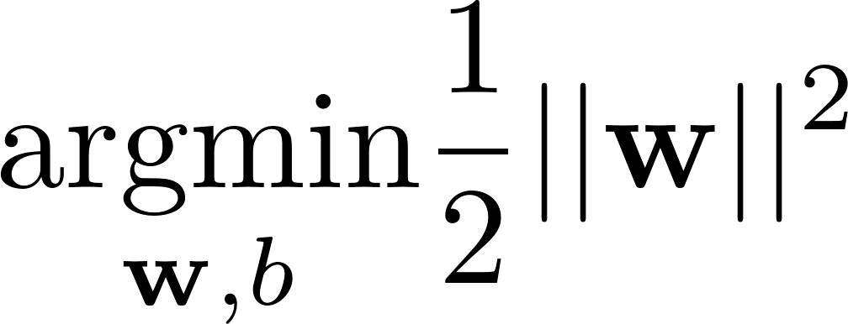
Here, we need to solve
With the constraints

Slide 12
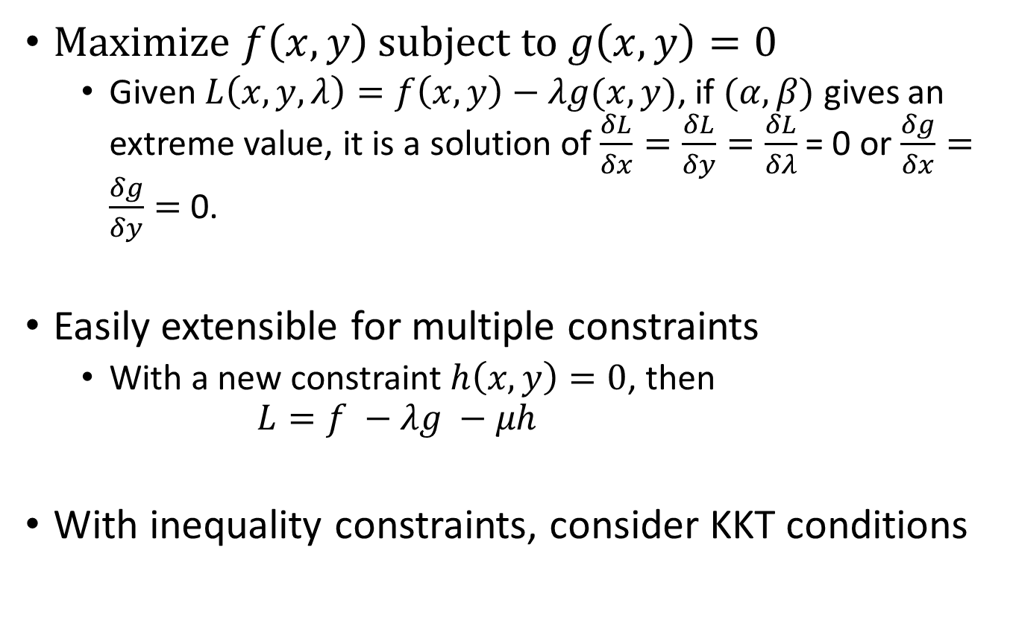
Lagrange multiplier
Maximize $f\left(x, y\right)$ subject to $g\left(x,y\right)=0$
Given $L\left(x, y, λ\right)=f\left(x, y\right)−λg(x, y)$, if $(α,β)$ gives an extreme value, it is a solution of $\frac{δL}{δx}=\frac{δL}{δy}=\frac{δL}{δλ}$ = 0 or $\frac{δg}{δx}=\frac{δg}{δy}=$ 0.
Easily extensible for multiple constraints
With a new constraint$h\left(x, y\right)=0$, then $L=f −λg −μh$
With inequality constraints, consider KKT conditions

Slide 13
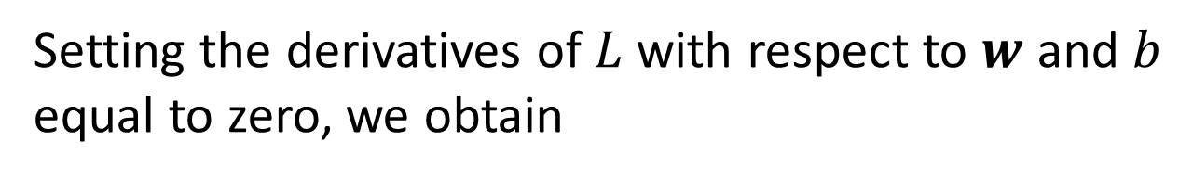
Lagrange multiplier
$L\left(w, b, a\right)=\frac{1}{2}\left|\left|w\right|\right|2−\sum_{n=1}^{N}{a_{n}\{t_{n}(wT}x_{n}+b) −1$ }
objective
Constraints
Setting the derivatives of $L$ with respect to $w$ and $b$ equal to zero, we obtain
$w= \sum_{n=1}^{N}{a_{n}t_{n}}x_{n}$ → Delete $w$
$\sum_{n=1}^{N}{a_{n}t_{n}}=0$ → Delete $b$

Slide 14
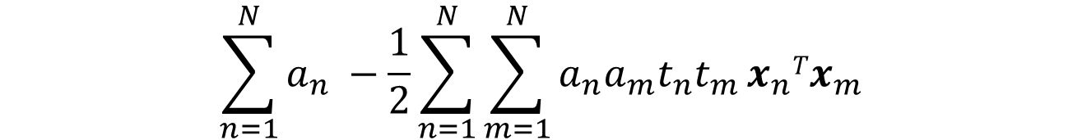
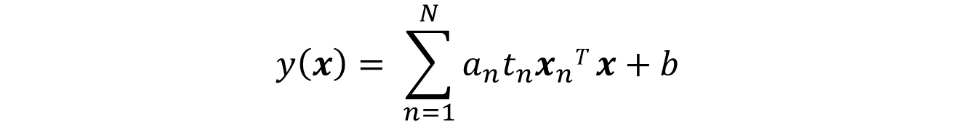
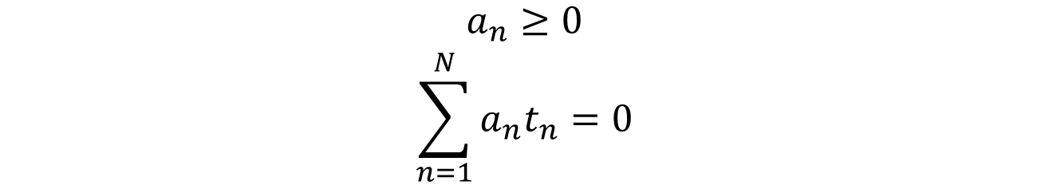
Lagrange multiplier
Maximize:
$$\sum_{n=1}^{N}{a_{n} −\frac{1}{2}}{\sum_{n=1}^{N}{\sum_{m=1}^{N}{a_{n}a_{m}t_{n}t_{m}}}x}_{n}Tx_{m}$$
With respect to $a$, subject to the constraints for $n=1…N$
$$\begin{aligned}a_{n}≥0 \\ \sum_{n=1}^{N}{a_{n}t_{n}=0}\end{aligned}$$
SMO algorithm is not covered
After finding $a$, we can classify new data,
$$y\left(x\right)= \sum_{n=1}^{N}{a_{n}t_{n}x_{n}T}x+b$$

Slide 15
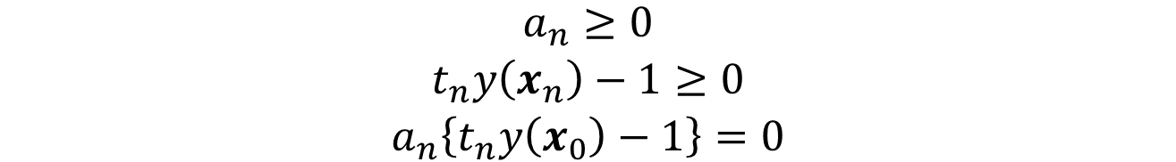
KKT condition
Lagrange function with inequality constraints has to satisfy the following condition, known as KKT conditions.
$$\begin{aligned}a_{n}≥0 \\ t_{n}y\left(x_{n}\right)−1≥0 \\ a_{n}\left\{t_{n}y\left(x_{0}\right)−1\right\}=0\end{aligned}$$

Slide 16
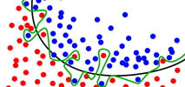
Soft-margin SVM
Allow misclassification
Input data is NOT linearly separable
The previous model could not handle this
Exact separation results in poor generalization

Slide 17
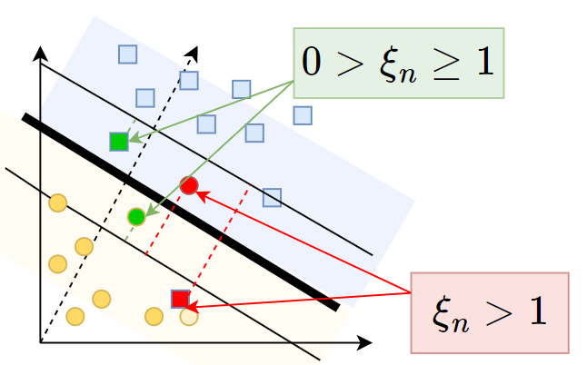

Slack variable: New constraints
$t_{n}\left({wTx}_{n}+b\right)≥1⇒$ $t_{n}\left({wTx}_{n}+b\right)≥1−ξ_{n}$
$ξ_{n}$ : slack variable
$ξ_{n}=0$ : Correctly classified and out of the margin
$0< ξ_{n}≤1$ : Correctly classified but in the margin
$ξ_{n}>1$ : Misclassified
$ξ_{n}≥0$

Slide 18

Slack variable
$t_{n}\left({wTx}_{n}+b\right)≥1⇒$ $t_{n}\left({wTx}_{n}+b\right)≥1−ξ_{n}$
$ξ_{n}$ : slack variable
$ξ_{n}=0$ : Correctly classified and out of the margin
$0< ξ_{n}≤1$ : Correctly classified but in the margin
$ξ_{n}>1$ : Misclassified

Slide 19
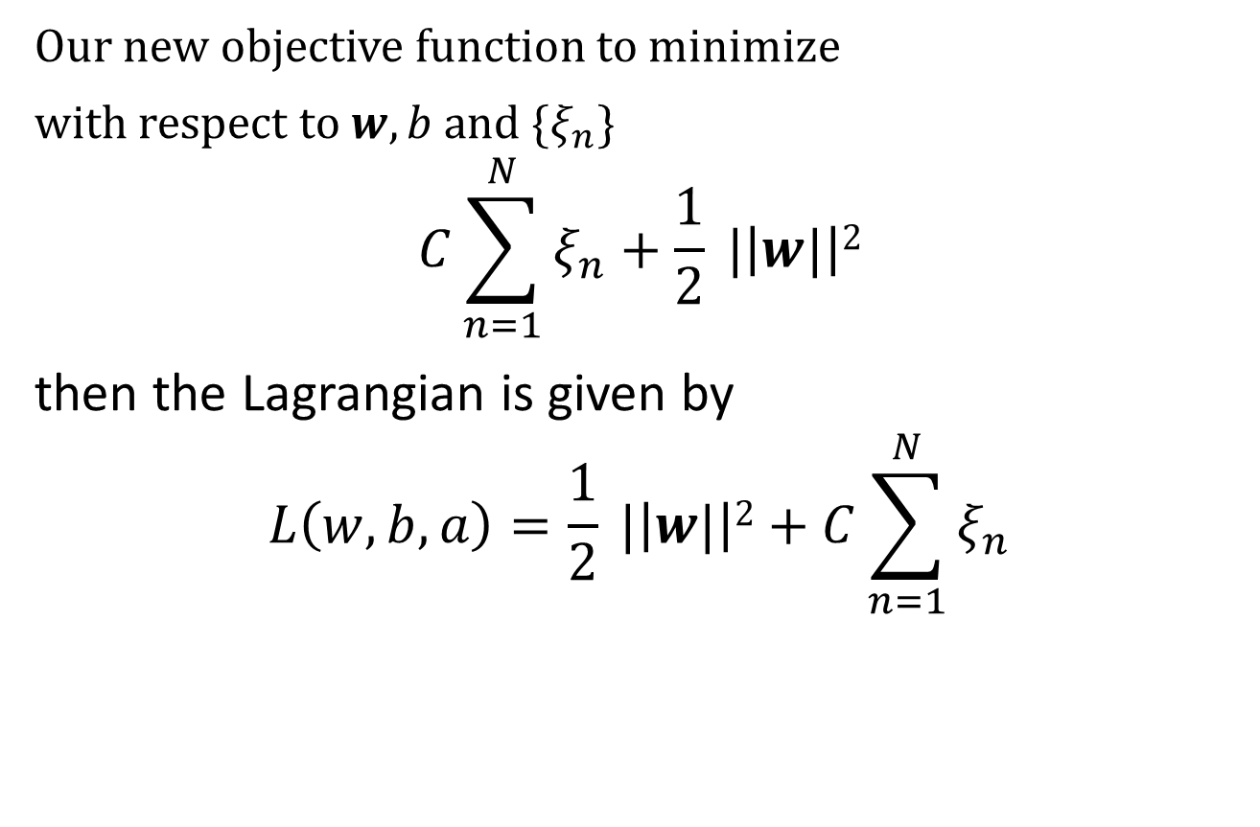
Penalty strength control by C
Our new objective function to minimize
with respect to $w, b$ and $\{ξ_{n}\}$
$$C\sum_{n=1}^{N}{ξ_{n}+\frac{1}{2} |\left|w|\right|2}$$
then the Lagrangian is given by
$$L\left(w, b, a\right)=\frac{1}{2} |\left|w|\right|2+C\sum_{n=1}^{N}{ξ_{n}}$$

Slide 20
Non-linear SVM

Slide 21
Kernel function

Slide 22
Kernel trick

Slide 23
Gaussian kernel and infinite space

